Slide 1
Coursera Capstone Project (The Battle of Neighborhoods)

Slide 2
Business Problem:
Location of restaurants is one of the most important decisions that will determine whether opening a restaurant will be a success or failure.
This projects aims to analyse and select the best location to open a new restaurant in NewYork city.
Business Question:
In the city of NewYork, if a developer is looking to open a restaurant,
where would you recommend that they open it.

Slide 3
Data Required: List of neighborhoods in NewYork City Latitude and Longitude coordinates of neighborhoods Venue Data, particularly data related to restaurants

Slide 4
Sources of Data
Wikipedia page for neighborhoods from the following link :
https://geo.nyu.edu/catalog/nyu_2451_34572
Geocoder package for latitude and longitude coordinates
Foursquare API to gather venue data

Slide 5
Methodology
Gather the data and populate it in Pandas Data Frame and then visualize the neighborhoods in a map using Folium package.
Use Foursquare API to get the top 200 venue data
Group data by neighborhood and taking the mean of frequency of occurrence of each venue category
Filter venue category by restaurants
Perform clustering of data using k means clustering
Visualize the clusters in a map using Folium

Slide 6
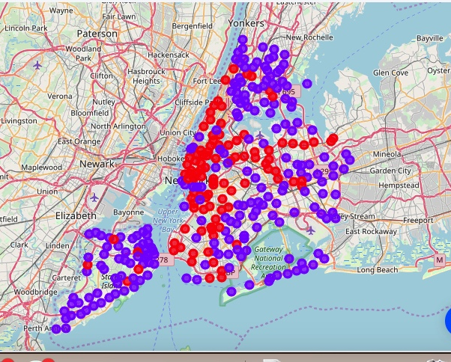
Results
Categorize the neighborhoods into 2 clusters:
Cluster 0 represents the neighborhoods with no restaurants wheras
Cluster 1 represents neighborhoods with high concentration of restaurants.

Slide 7
Discussion
Cluster 1 has high number of restaurants located in various neighborhoods of Manhattan, Bronx, Queens, Brooklyn and Staten Island.
Cluster 0 has no restaurant in Clason Point neighborhood of Bronx and a few neighborhoods of Staten Island.
This project recommends developers to capitalize on these findings to open new restaurants in selected neighborhoods of cluster 0 with no competition.

Slide 8
Conclusion
The answer proposed to the business problem is : The selected neighborhoods in cluster 0 are the most preferred location to open a restaurant.
The findings of this project will help the relevant company to capitalize on the opportunities of high potential locations while avoiding overcrowded areas to open a new restaurant.

